Slide 1
Credit card faurd detection
Using python

Slide 2
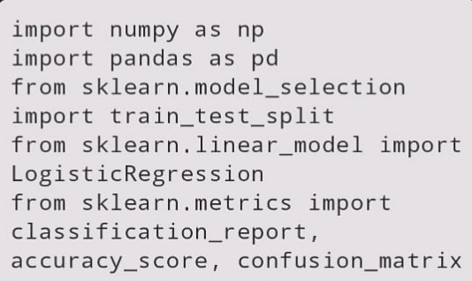
IMPORT NECESSARY LIBRARIES
In this step, you import the required Python libraries, including NumPy for numerical operations, Pandas for data manipulation, and Scikit-Learn modules for machine learning tasks.

Slide 3
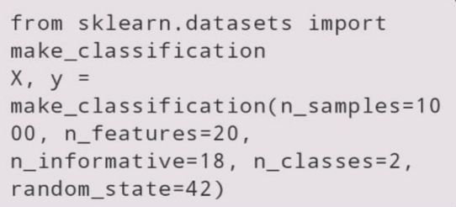
GENERATE SAMPLE DATASET
This code generates a synthetic dataset using `
make_classification` from Scikit-Learn. It creates 1000 samples with 20 features, where 18 features are informative. The dataset is binary classification with two classes.

Slide 4
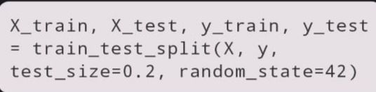
SPLIT THE DATA INTO TRAINING AND TESTING SETS :
The dataset is split into training and testing sets using the `train_test_split` function. In this case, 80% of the data is used for training (X_train, y_train), and 20% is reserved for testing (X_test, y_test).

Slide 5
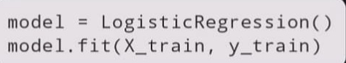
TRAIN A LOGISTIC REGRESSION MEODEL :
You create a Logistic Regression model and train it using the training data (X_train, y_train).

Slide 6
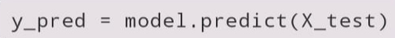
MAKE PREDICTIONS ON TEST SET :
The trained model is used to make predictions on the test data, resulting in `y_pred`.

Slide 7
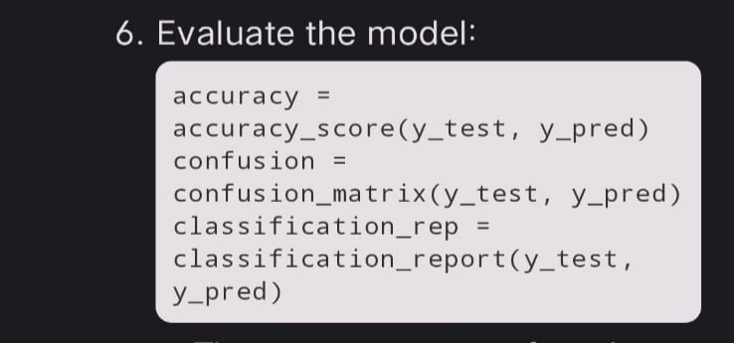
EVALUATE THE MODEL:
- The `accuracy_score` function calculates the accuracy of the model's predictions on the test set.
- The `confusion_matrix` function generates a confusion matrix, which provides information about true positives, true negatives, false positives, and false negatives.
- The `classification_report` function generates a report with precision, recall, F1-score, and support for each class.

Slide 8
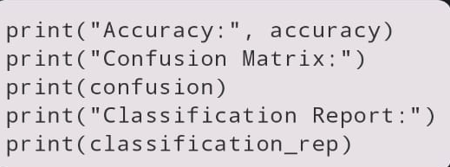
PRINT THE RESULTS :
Finally, the code prints the accuracy, confusion matrix, and classification report to evaluate the model's performance.
This code essentially demonstrates the process of training a simple logistic regression model for binary classification and evaluating its performance using standard machine learning metrics.

